Slide 1
Characteristics of Living Things and Classification, Taxonomy, Cladograms
Unit 10

Slide 2


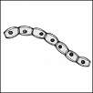
Living things are Made of cells.
Cell: living matter enclosed by a barrier that separates it from its surroundings. – The smallest unit of life.

Slide 3
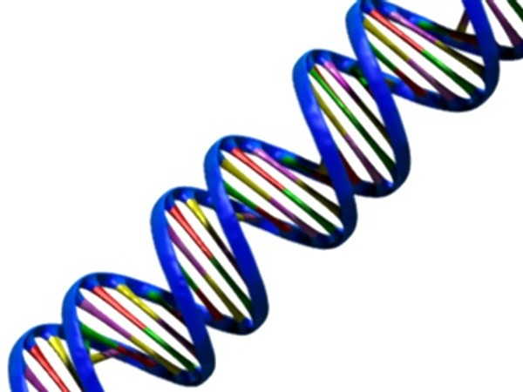
2. Living things are based on a universal genetic code.
Organisms inherit their genetic traits from DNA.

Slide 4
3. Living things Grow & Development
All living things grow & develop
Some remain unicellular ( single-celled)
Others differentiate and become multicellular (many-celled)
    Cell specialization: cells throughout an organism can develop in different ways to perform different tasks

Slide 5
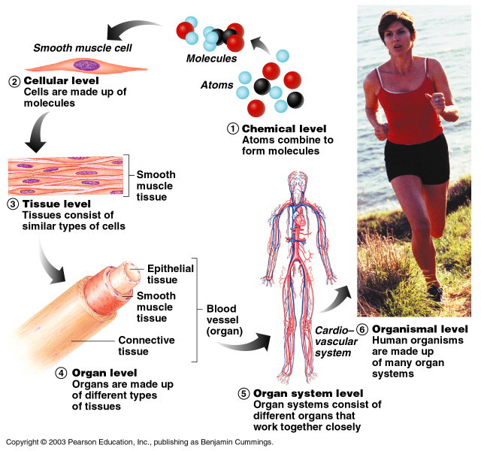
Levels of Organization
Multicellular organism
  Individual cells
  Tissues: groups of similar cells that perform a particular function
  Organs: groups of tissues that work together
  Organ systems: group of organs that work together to perform a specific function (digestive system)

Slide 6

4. Living things Reproduce.
Two Kinds:
  Sexual: Sperm + egg= offspring
    Offspring differ from parents in some traits
  Asexual: 2 ways
    Parent cell divides and becomes two identical offspring (Cell division / mitosis). Offspring & parents have same traits
    part of the parent breaks off to form new organism (Budding)

Slide 7
5. Living things Obtain & Use Energy
Organisms need energy to grow and develop (Food Chain)
Metabolism:
  Combination of chemical reactions where an organism builds up or breaks down materials

Slide 8
6. Living things respond and adapt to their environment.
Living organisms have the ability to adapt and respond to stimuli, increasing its chance of survival.

Slide 9

7. Living things maintain a stable internal environment.
Homeostasis is the means by which the internal bodies conditions are kept constant.
WATER
GLUCOSE
TEMPERATURE
Notes:
9
Description:
Sporangia dot the underside of a fern frond. These structures release spores, which are the means of reproduction for these non-flowering plants. Spores sprout into tiny plants that hold both male and female parts. These unite, producing a new fern plant.

Slide 10
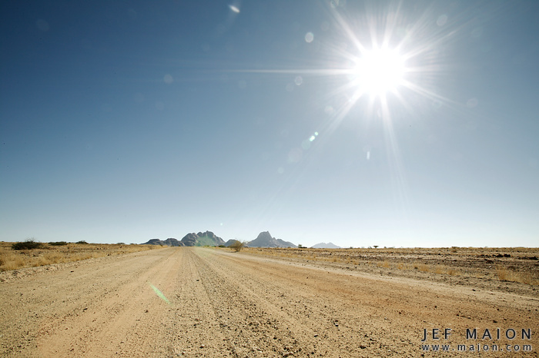
What would happen if?
You sit outside in the hot sun all day

Slide 11
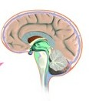
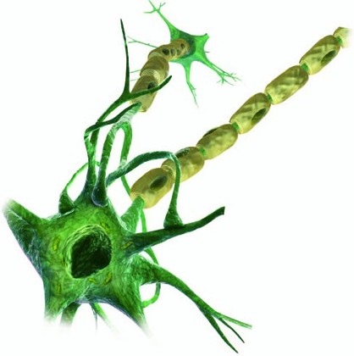
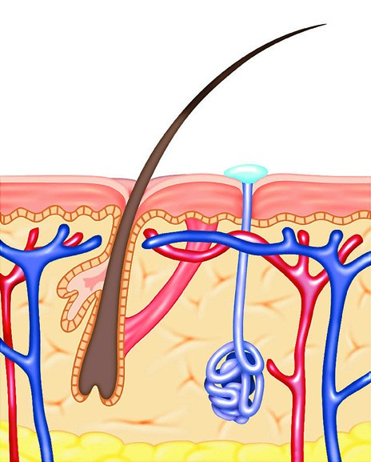
Original stimulus:
Body temperature increases
= Positive Feedback
Homeostasis- the internal bodies conditions are kept constant
Response: Skin and sweat receptors are activated = body temperature falls
Result: response action stops when brain detects “normal conditions”
= Negative feedback
Message: sent via nerves

Slide 12
If something does not have all of the characteristics listed above, then it is NOT considered a living thing!

Slide 13
Classification
Classification Brain Pop

Slide 14
Classification
Taxonomy- the field of Biology that identifies and classifies organisms.
Carolus Linnaeus- Developed the classification system in mid 1700’s. He used a grouping format classifying the very broad groups (least related or the least amount of similarities) to very specific (more precise) members.
Each level is called a taxon, or taxonomic category.

Slide 15
Domain
Kingdom
Phylum
Class
Order
Family
Genus
Species
Domain | Did
Kingdom | King
Phylum | Phillip
Class | Come
Order | Over
Family | For
Genus | Good
Species | Soup

Slide 16
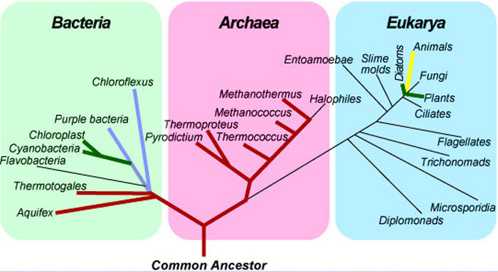
The Three-Domain System
The domain is a more inclusive category than any other—larger than a kingdom.
The 3 domains are
      1 Bacteria
      2 Archaea
      3 Eukarya

Slide 17
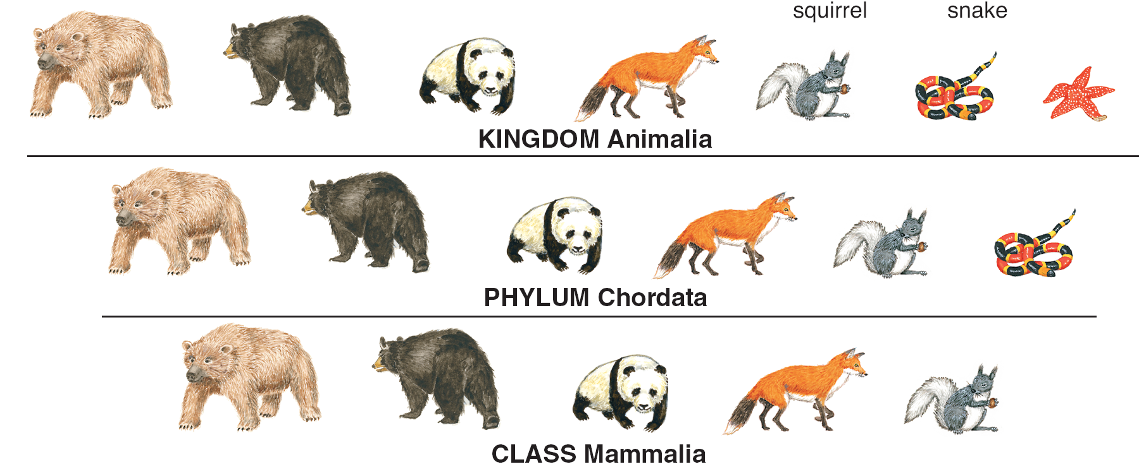
The kingdom is the largest and most inclusive of Linnaeus's taxonomic categories (not including domain).

Slide 18
Six Kingdoms
  The six-kingdom system of classification include:
    Eubacteria
    Archaebacteria
    Protista
    Fungi
    Plantae
    Animalia
Brain Pop Kingdoms

Slide 19
Several different classes make up a phylum.
**Phyla is the plural form of the word.

Slide 20
The next larger category, the class, is composed of similar orders.

Slide 21
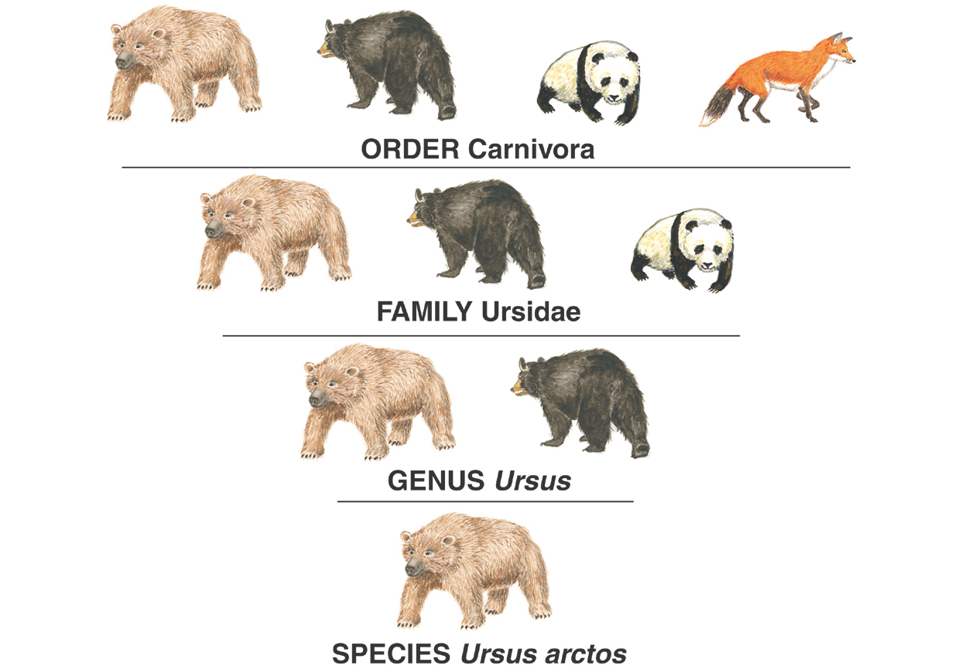
An order is a broad category composed of similar families.

Slide 22
Genera that share many characteristics are grouped in a larger category, the family.

Slide 23
Genus and Species are the two smallest categories
*Genera is the plural form of genus.

Slide 24
Binomial Nomenclature: “two-word” naming system used to identify organisms. All organisms have 2 names:
1. Scientific Name - consists of a genus name and a species name.
Genus is always written 1st and IS CAPITALIZED.
species is always written 2nd and is NOT capitalized.
*Both names are printed and underlined or in Italics
Ex: Homo sapiens or Homo sapiens
Ex: H. sapiens or H. sapiens
2. Common name- name that is used more regularly.
Ex: Mountain lion, puma, cougar, panther… all
common names for the same animal depending on
the region.

Slide 25
Modern Evolutionary Classification
Phylogeny- study of evolutionary relationships among organisms
Biologists group organisms into categories that represent lines of evolutionary descent, or phylogeny, not just physical similarities.
Organisms that share the same genus are more closely related than organisms that only share the same class.
They also use DNA to observe how closely related organisms are

Slide 26
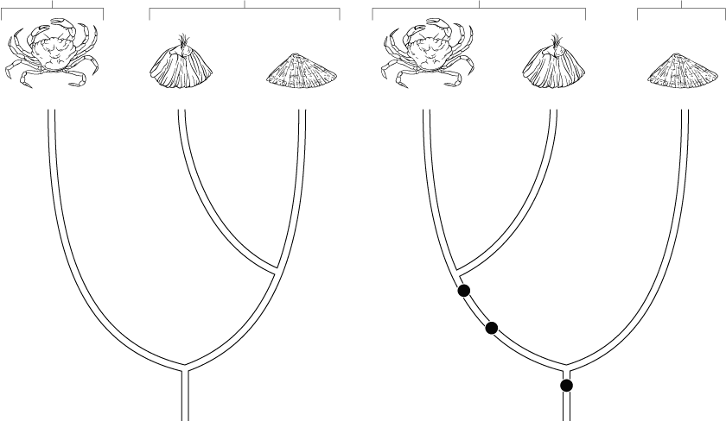
Derived Characters
Characteristics that appear in recent parts of a lineage, but not in its older members can be used to construct a Cladogram.
  A cladogram is a diagram that shows the evolutionary relationships among a group of organisms.

Slide 27
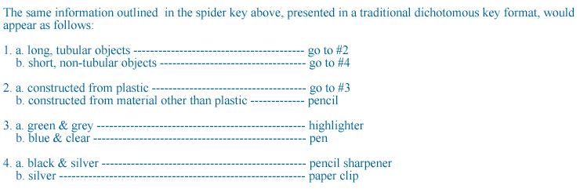
Dichotomous Keys
A tool used for identifying organisms by using specific observable traits of the organism.
Ex. Dichotomous Key for Common Classroom Supplies

Slide 28
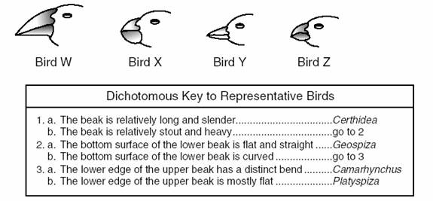
Bird Dichotomous Key
Always start at number 1!!!!!

Slide 29
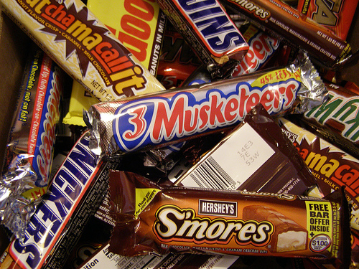

A visual representation of the evolution of chocolate bars

Slide 30
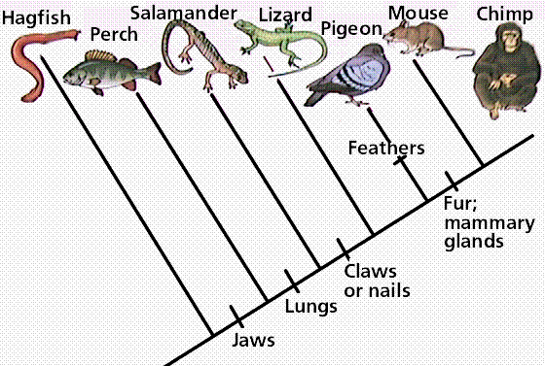
What is a Cladogram?
A cladogram shows the evolutionary relationships between organisms. By looking at it, you can tell how closely related two organisms are. You can determine their evolutionary path and timeline.

Slide 31

A cladogram will start with the oldest common ancestor. This is usually the simplest organism since other organisms will evolve as more complex versions or altered forms of this original species.
So, we’re going to start our chocolate cladogram with the ORIGINAL chocolate bar- the plain chocolate bar.

Slide 32
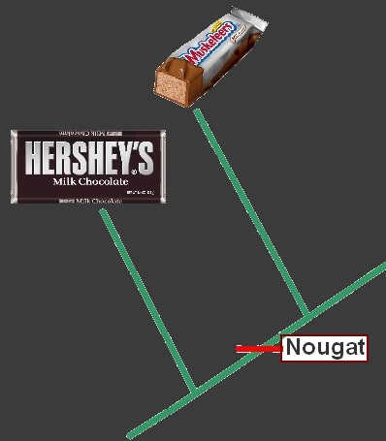
Now evolution leads to speciation and a new species of chocolate bars form. This species is unique from the previous species of chocolate bars because it contains nougat. So we will put it further up on a line from the original chocolate bar and label on the line what makes this bar unique.

Slide 33
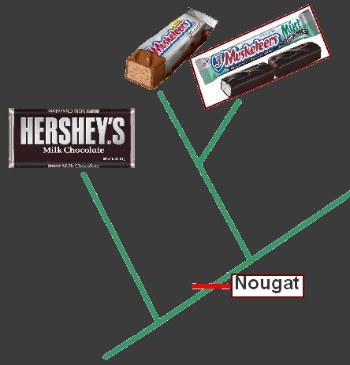
If there are two species expressing nougat we put both of the nougat bars next to each other on the cladogram to show how closely related they are and to show that they evolved at the same time.

Slide 34
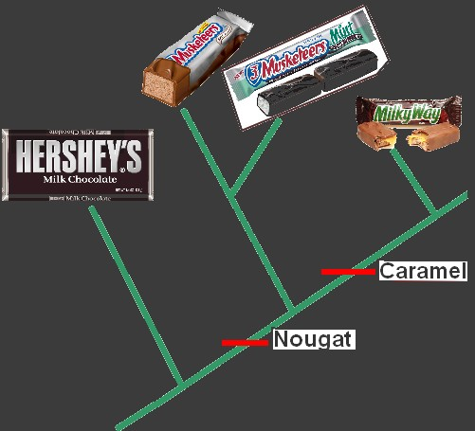
As speciation continues we are sure to add the NEW adaptations on the cladogram so that we can make the distinction between candy bars more clearly. CARAMEL is the newest adaptation.

Slide 35
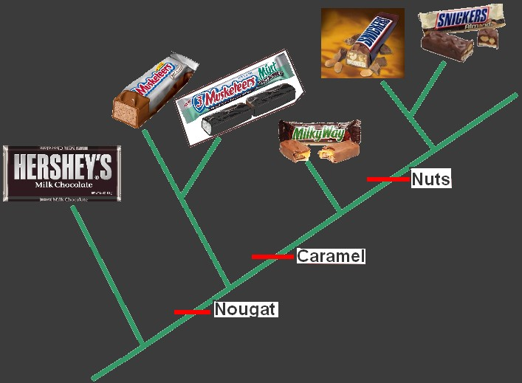
So we can look at the cladogram and see that snickers peanut is most closely related to snickers almond. It is also more closely related to milky way than it is to 3 musketeers!
Finally, the milky way bars develops the adaptation of nuts! And again, we have two different bars evolve at this point- the bar with peanuts and the bar with almonds!
Notes:
35

Slide 36
Cladograms can also be called “phylogenies” or “trees” or “phylogenetic trees”.
Remember, the definition of phylogeny is: the study of evolutionary relationships among organisms.

Slide 37
