Slide 1
MICROORGANISMS BACTERIA
BRAINPOP: BACTERIA

Slide 2
CHARACTERISTIC OF BACTERIA
SMALL – I mean, seriously tiny!
Most bacteria are only 1 – 2 microns (also known as micrometers, μm) in diameter. The smallest bacteria is between 0.2 - 0.3 microns in diameter, whereas the largest bacteria has measured up to 600 μm (visible to the naked eye!) This is about a million times larger than E. Coli.
A strand of hair is about 100 microns wide and a red blood cell is about 8 microns in diameter.
It takes about 25,000 microns to measure to 1 inch.
SIZE COMPARISON CHART

Slide 3
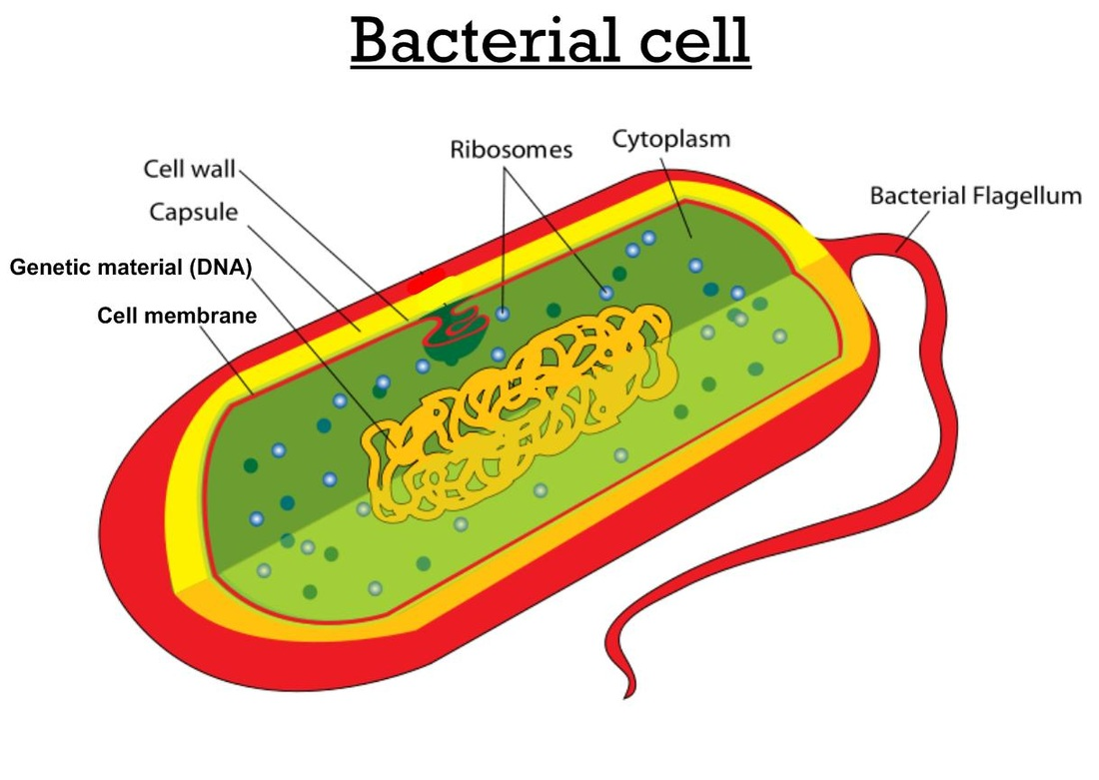
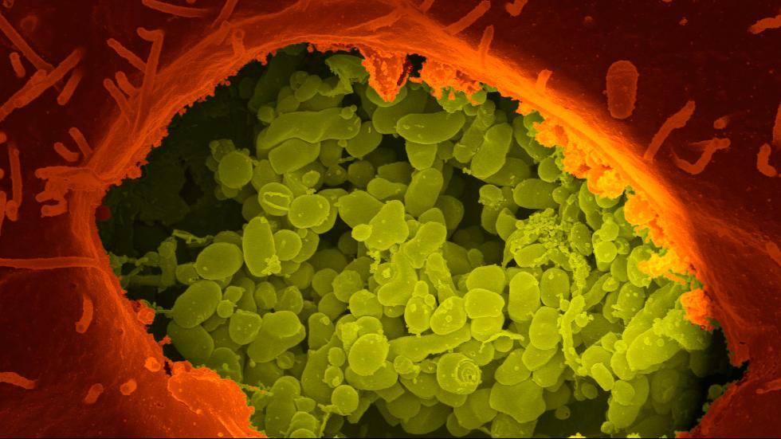
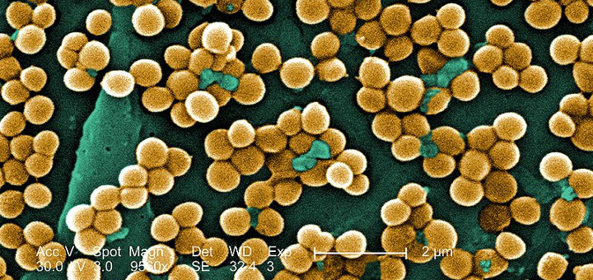
CHARACTERISTIC OF BACTERIA
UNICELLULAR
Although some bacteria may live in colonies, all bacteria are single-celled organisms.
MRSA
Coxiella burnetii

Slide 4
CHARACTERISTIC OF BACTERIA
PROKARYOTIC
Bacteria have genetic material, DNA, but they lack a nucleus or membrane-bound organelles.

Slide 5
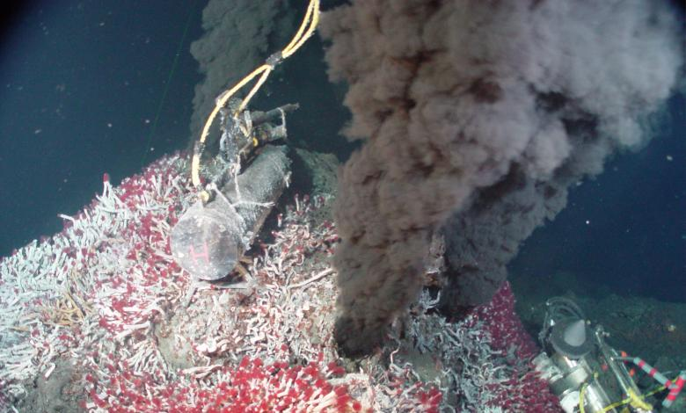
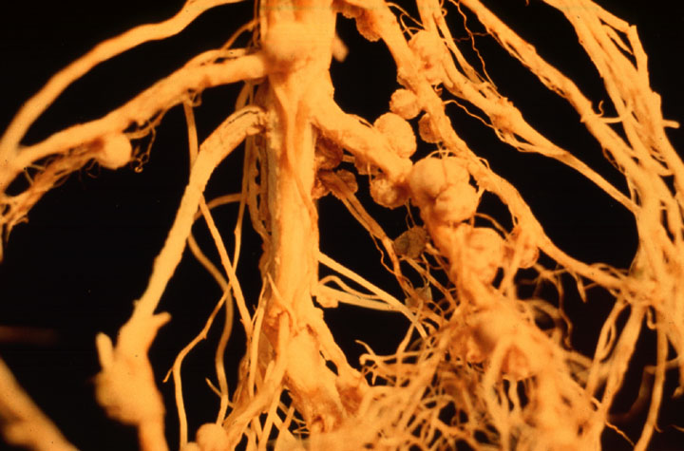
CHARACTERISTICs OF BACTERIA
LIVE EVERYWHERE
From deep ocean vents to an animal’s large intestine, bacteria are able to live and thrive in a variety of different environments. There can be as many as 3 million bacteria found in only 1 gram of soil!
Specialized bacteria utilize the high density of sulfur or methane compounds to create food/energy, again forming the bottom of a complex food web
Nodules formed where Rhizobium bacteria infected soybean roots.

Slide 6
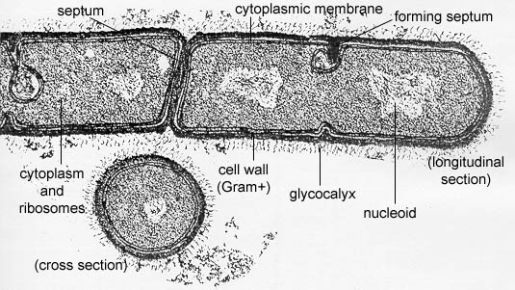
CHARACTERISTIC OF BACTERIA
HAVE A CELL WALL
All bacteria have a cell wall. The cell wall of Eubacteria contains the polymer peptidoglycan, while the cell wall of Archaebacteria does not.

Slide 7
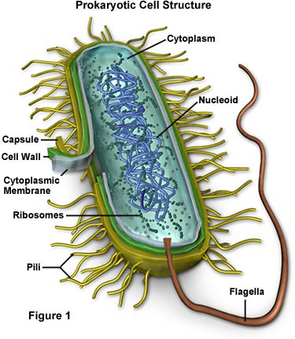
CHARACTERISTICS OF BACTERIA
MOTILITY
Bacteria may have flagella (a whip-like tail) or pili (hair-like appendages on the surface of the bacterium) for movement.

Slide 8
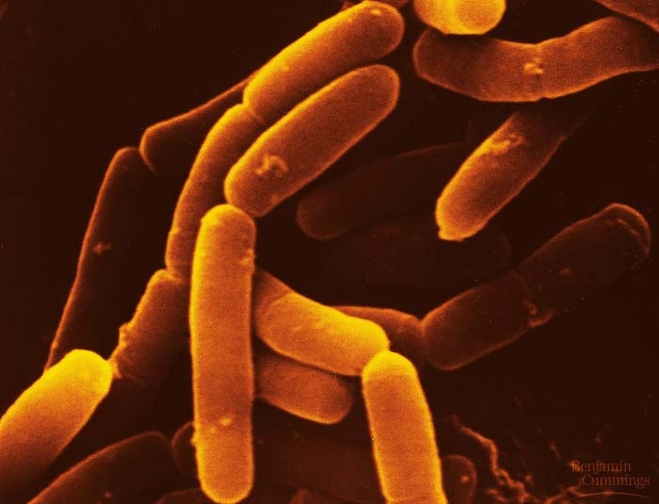
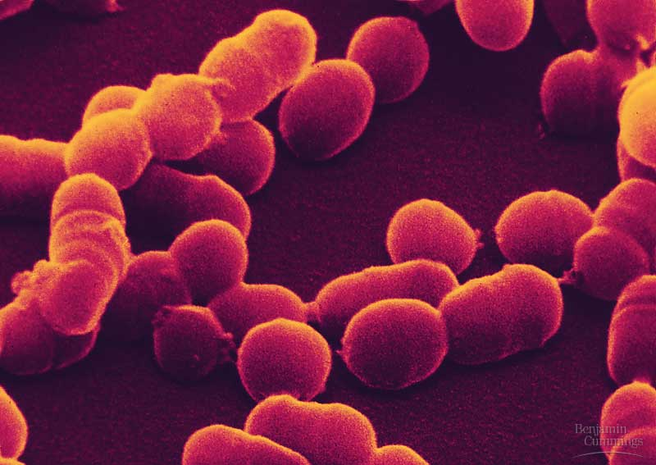
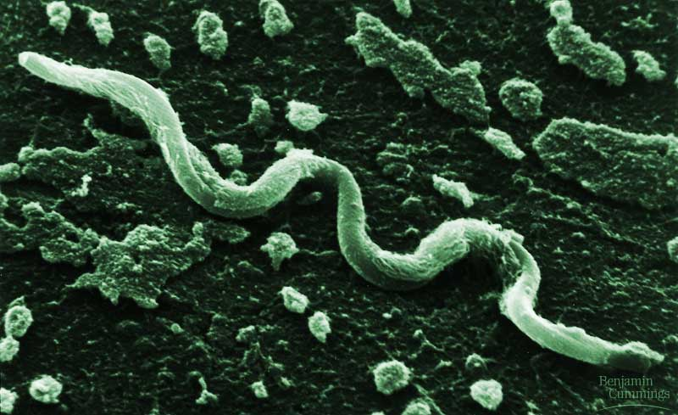
CHARACTERISTIC OF BACTERIA
SHAPE
Bacteria can be a variety of different shapes, but the 3 most common are:
Bacilli: Rod – Shaped Cocci: Round - Shaped Spirilla: Spiral – Shaped

Slide 9
CHARACTERISTICS OF BACTERIA
PREFIXES USED TO DESCRIBE AND IDENTIFY BACTERIA
DIPLO = 2 ex.) Diplococcus meningitis
STREPTO = chain ex.) Streptococcus pneumonia
STAPHYLO = clumps ex.) Staphylococcus aureus

Slide 10
CHARACTERISTICS OF BACTERIA
NUTRITION
May be autotrophs or heterotrophs.
Photoautotrophs – use light energy to make food.
Chemoautotrophs – use chemicals to make food.
Photoheterotrophs – photosynthetic, but must also consume organic compounds from the environment.
Chemoheterotrophs – require nutrition; do not perform photosynthesis.

Slide 11
CHARACTERISTICS OF BACTERIA
IDENTIFICATION
Gram staining – a procedure developed to identify bacteria so that it can be treated with the appropriate antibiotic.
Gram Positive results mean that the stain will be purple and that the cell wall of the bacteria contains a thickened layer of peptidoglycan.
Gram Negative results mean that the stain will be red and that the cell wall of the bacteria contains a thin layer of peptidoglycan and an extra membrane that cannot retain the stain. The extra membrane helps the bacteria to better resist damage.

Slide 12
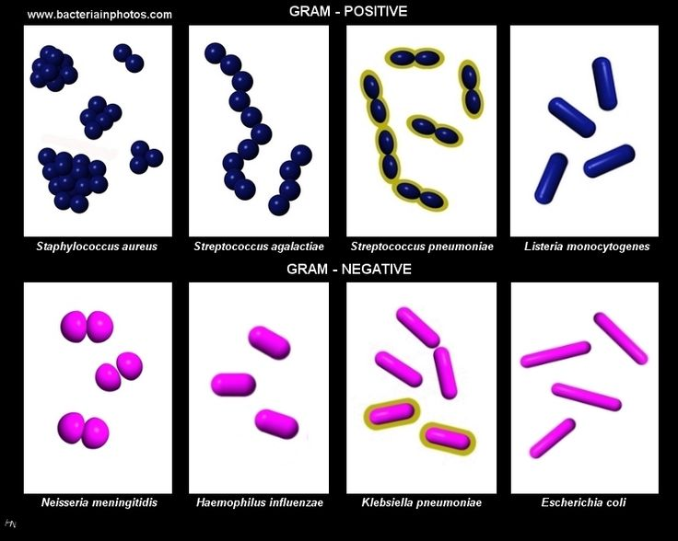
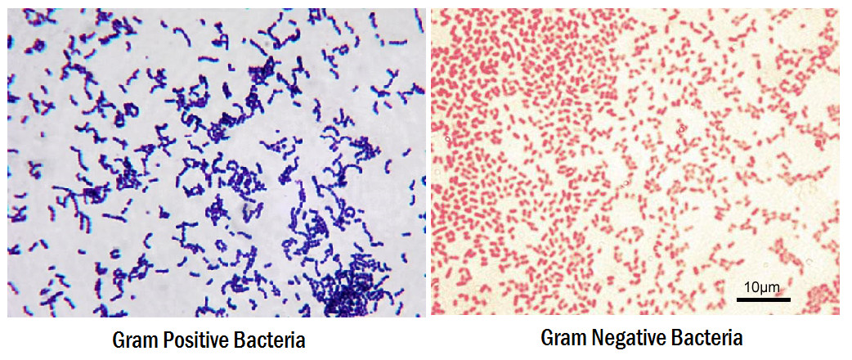
CHARACTERISTICS OF BACTERIA
GRAM STAINING
Identifying bacteria is used by doctors so they know what is making you sick and can make sure they prescribe you the correct antibiotics.

Slide 13
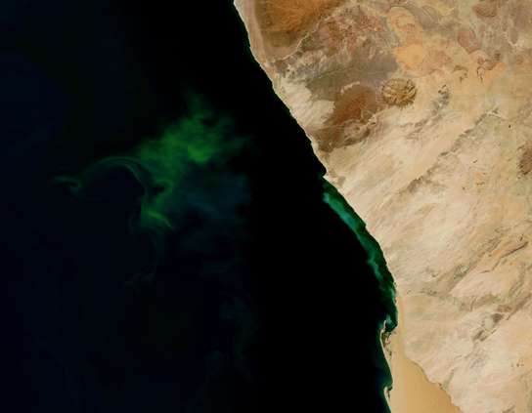
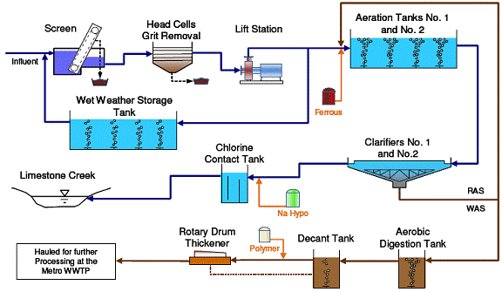
CHARACTERISTIC OF BACTERIA
RELEASING ENERGY
Bacteria must go through cellular respiration to produce energy.
Aerobic respiration uses oxygen to break down glucose into carbon dioxide and water
Anaerobic respiration uses other molecules (like NITRATES!) to break down glucose
The green color seen in these coastal waters is from an eruption of hydrogen sulfide-producing bacteria. These anaerobic, sulfate-reducing bacteria release hydrogen sulfide gas as they decompose algae in the water.
Water Treatment Plants use both Aerobic and Anaerobic microbes to break down sewage and remove pollutants to reduce the impact of waste in the environment

Slide 14
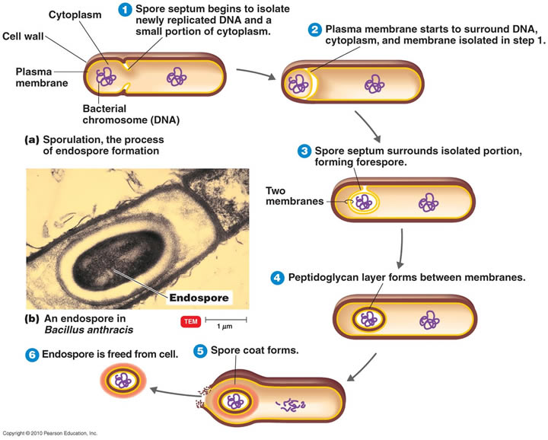
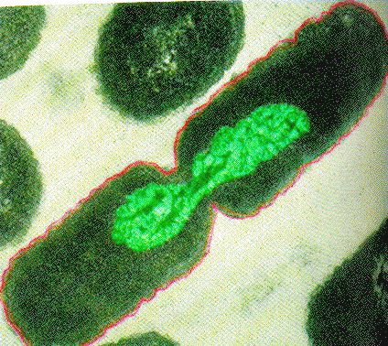
CHARACTERISTICS OF BACTERIA
REPRODUCTION
Bacteria can reproduce either sexually or asexually.
Binary fission – asexual reproduction in which the DNA of the bacteria cell is copied and then the bacteria splits in two.
Spore formation – asexual reproduction in which endospores form so that bacteria can remain dormant in harsh conditions and then germinate when conditions become favorable.
Conjugation – sexual reproduction in which genetic material is transferred between two bacterium through direct contact.
Click on images
for details
Spore Formation
Conjugation
Binary Fission

Slide 15
IMPORTANCE OF BACTERIA VS. DANGERS OF BACTERIA
IMPORTANCE
DANGERS
Decomposers – recycle nutrients, clean up environmental hazards like oil spills
Nitrogen fixation
Photosynthesis – release oxygen into the environment
Aid in digestion and produce vitamins – mutualistic relationship between E. Coli and humans
Food production - such as cheese and yogurt
Medicines and medical treatments
Clostridium botulinum – BOTOX (it’s not just for wrinkles!)
Lactobacillus acidophilus - probiotics
Pathogenic bacteria - cause of many common and potentially deadly illnesses
Streptococcus pneumoniae – pneumonia & meningitis
Streptococcus areus – strep throat
Bordetella pertussis – whooping cough
Food poisoning and ear infections are caused by a range of different bacteria
Antibiotic resistance – bacteria can be treated with antibiotics, however, more bacteria are developing a resistance to treatments.
Biowarfare
Bacillus anthracis – anthrax
Clostridium botulinum – botulism

Slide 16
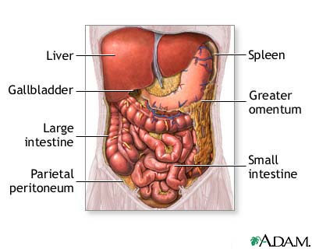
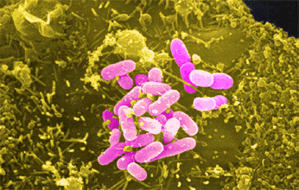
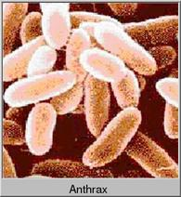
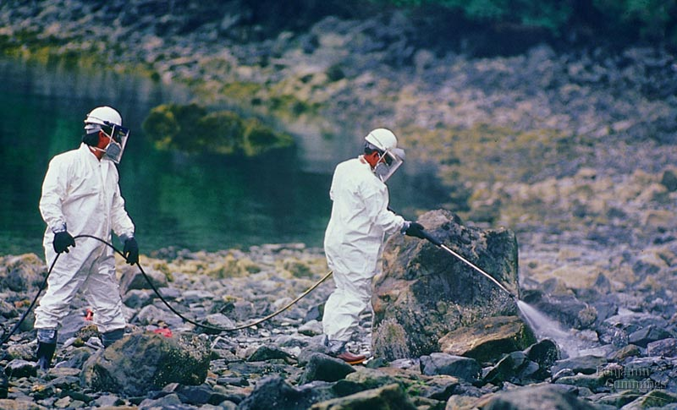
IMPORTANCE VS. DANGERS
IMPORTANCE
DANGERS
ANTHRAX VIDEO CLIP
CELL PHONE BACTERIA CLIP
IMPORTANCE OF HANDWASHING
GOOD BACTERIA LINK

Slide 17
ARCHAEBACTERIA VS. EUBACTERIA
ARCHAEBACTERIA
EUBACTERIA
Ancient
Lack peptidoglycan
Live mostly in harsh conditions (salty lakes, thick mud, ocean vents, guts of animals)
Considered “true bacteria”
Peptidoglycan present
Live almost everywhere
Where Bacteria Live Clip

Slide 18
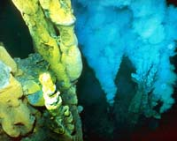
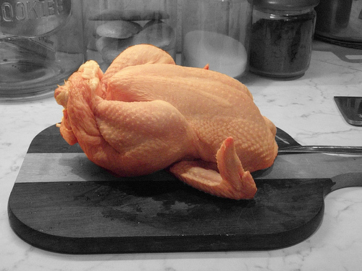
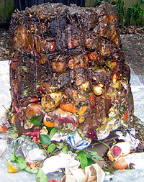
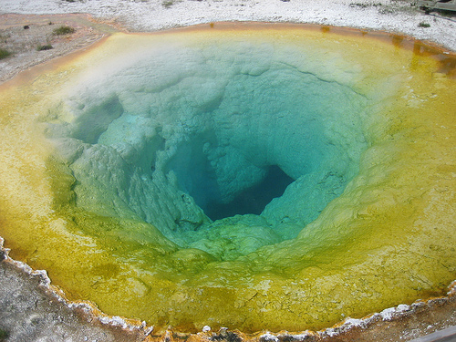
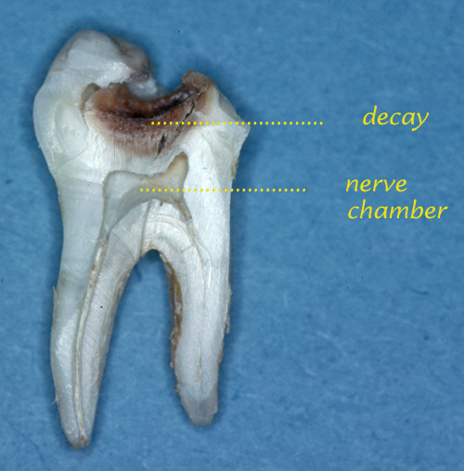
ARCHAEBACTERIA VS. EUBACTERIA
ARCHAEBACTERIA
EUBACTERIA
Deep Ocean Vent
Food
Compost
Hot Spring Pool in Yellowstone
Cavities

Slide 19
Interesting articles and links
Sewage Plants May be Creating “Super” Bacteria
Dr. Semmelweis
http://www.typesofbacteria.co.uk/how-when-were-bacteria-discovered.html
https://blogs.scientificamerican.com/disease-prone/peptidoglycan-the-bacterial-wonder-wall/

