Slide 1
WARM UP Tues. (5/12)/Wed. (5/15)
In recent years humans have interfered with the natural balance within deer populations in various ecosystems. The interference includes eliminating predators of the deer. Which of the following statements correctly describes the long-term outcome of this interference?
F. The deer that are the fastest and most agile will survive and reproduce.
G. The deer population will be too large to be supported by producers.
H. Other browsing species will thrive and outcompete the deer.
J. The producers will evolve into species that are less palatable to the deer.
Answer: G
Exam: Binder Test 5/24 and 5/25

Slide 2
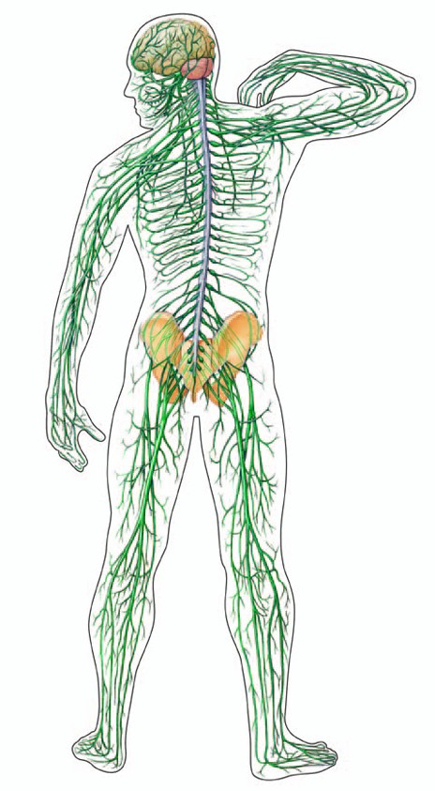
The Nervous System
http://www.brainpop.com/health/bodysystems/nervoussystem/

Slide 3
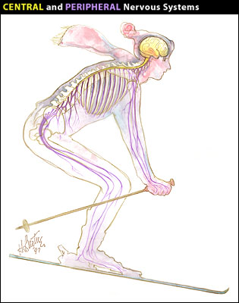
The Nervous System (nothing to write)
Structures: Neuron, brain, spinal cord, nerves.
Function: The nervous system coordinates the body’s response to changes in the internal and external environment.

Slide 4
How the Nervous System Works:
A neuron is the smallest structural and functional unit of the Nervous System
A nerve impulse occurs as chemical change as it moves through a neuron
Dendrites carry impulses to the cell body.
Axons carry impulses away from the cell body.

Slide 5
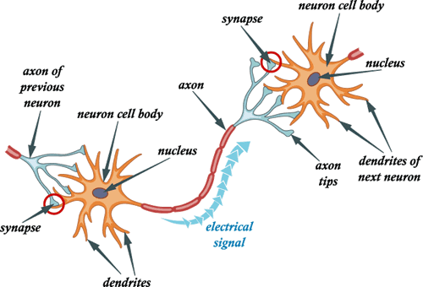
NEURONS COMMUNICATING
Neuron send messages from the brain to the body, one neuron to the next
http://www.brainpop.com/health/bodysystems/neurons/

Slide 6
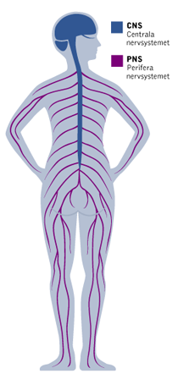
Parts of the Nervous system
The Nervous System has two major divisions.
The Central Nervous System (CNS)
The Peripheral Nervous System (PNS)

Slide 7
The Central Nervous System
Consists of the brain and spinal cord.
They act as your body’s central coordinating and
processing unit.
The functions of the CNS are:
Relay messages (only one blank on your notes)
Process information (the second blank on your notes)
Analyze information

Slide 8
The Brain
Brain Song http://www.youtube.com/watch?v=1BFomkzktto
Cerebrum controls the conscious activities of the body.
Cerebellum governs balance and coordination
Medulla oblongata controls breathing
Hypothalamus is the part of the brain that recognizes hunger, thirst, and body temperature.
http://www.brainpop.com/health/bodysystems/brain/

Slide 9
The Cerebrum The home of all your thoughts and feelings (nothing to write)
This is responsible for sensation, for feeling touch and pain
This is responsible for problem solving, abstract thinking and movement.
This is responsible for vision, your eyes connect to here
This is responsible for memory and emotion
10 amazing facts about the brain: http://www.youtube.com/watch?v=wmcHH4wPpMU

Slide 10
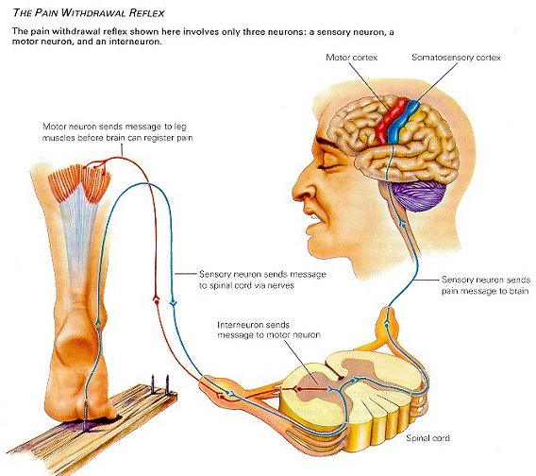
The Spinal Cord
Allows us to use reflexes.
We can act upon a stimulus without involving the brain.
Much quicker
http://www.youtube.com/watch?v=38zEmPuWd-o
http://www.youtube.com/watch?v=Y5nj3ZfeYDQ

Slide 11
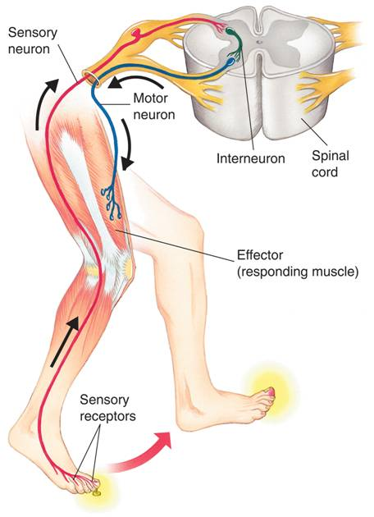
A SPINAL REFLEX
(NOTHING TO WRITE)
You step on a nail! A sensory neuron starts sending a message about the pain. Before it gets to the brain,the spinal cord gets the message and immediately send a motor neuron to your foot to tell you to move your foot!
Notes:
The peripheral nervous system transmits impulses from sense organs to the central nervous system and back to muscles or glands. When you step on a tack, sensory receptors stimulate a sensory neuron, which relays the signal to an interneuron within the spinal cord. The signal is then sent to a motor neuron, which in turn stimulates a muscle in your leg to lift your leg.

Slide 12
Peripheral Nervous System
Consists of all the nerves that are not part of the brain and the spinal cord.
Contains all the sense organs of the body
***Synesthesia: http://www.youtube.com/watch?v=vEqmNX8uKlA

Slide 13
SENSORY NEURONS
Sensory Neuron: Neurons that react directly to
stimuli from the environment.
Photoreceptors- rods and cones which help us see
Thermoreceptors help us maintain body temperature
Free Nerve endings allow us to feel pain
Other receptors are sensitive to touch and pressure

Slide 14
Two Divisions of the PNS
The two divisions of the PNS are the:
Sensory Division Carries messages from the sense organs to the CNS
Motor division carries messages from the CNS to the muscles

Slide 15
The Motor Division
The motor division is further
divided into the
Somatic nervous system: which regulates activities that are under conscious control. Such as movement of the skeletal muscles.
Autonomic Nervous System: regulates activities that are automatic or involuntary.

Slide 16
AUTONOMIC NERVOUS SYSTEM (nothing to write)

Slide 17
Cool Nervous System Videos
Cow brain dissection: http://www.youtube.com/watch?v=rQ8Wx8IqlSI
Cerebral Palsy Brainpop http://www.brainpop.com/health/diseasesinjuriesandconditions/cerebralpalsy/
How heroin affects your brain http://www.youtube.com/watch?v=E4DnEgZkqwU
How Alzheimer’s Disease impacts the brain http://www.youtube.com/watch?v=NjgBnx1jVIU
MS and the nerve cell http://www.youtube.com/watch?v=o4YkqRUErPY

Slide 18
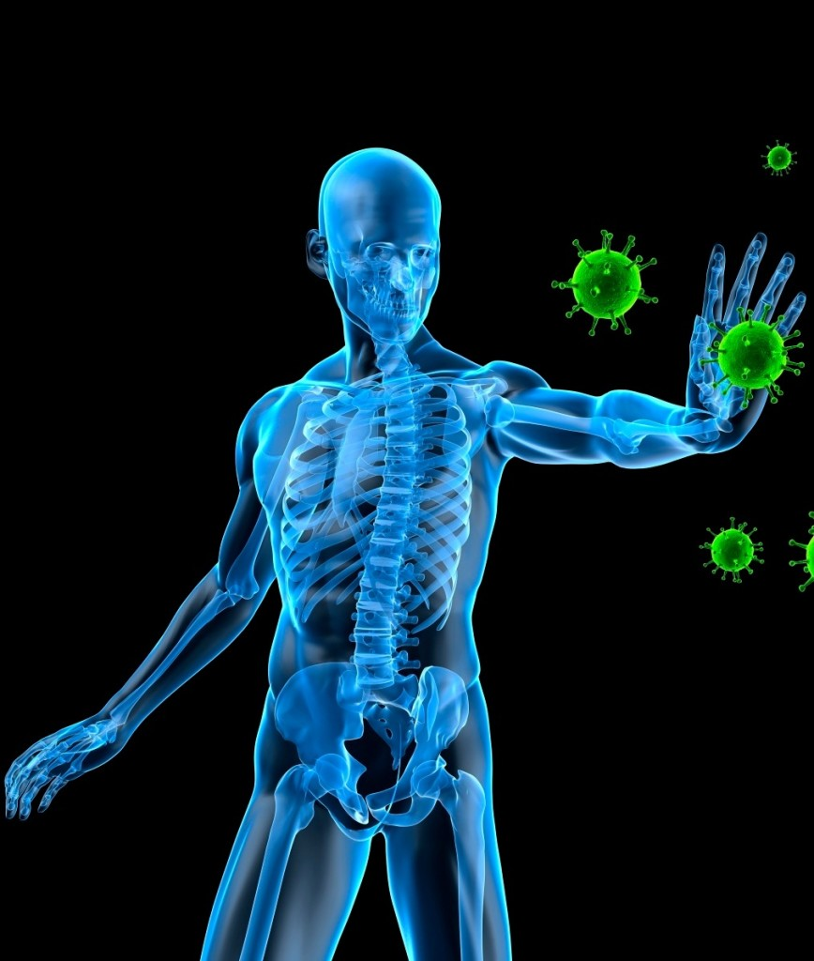
The Immune System
https://www.brainpop.com/health/bodysystems/immunesystem/

Slide 19
Structures and Functions
Structures: antibodies, antigens, lymphocytes, white blood cells (WBC’s)
Function: to fight infection through the production of cells that inactivate or destroy foreign substances or cells. This process is called defenses.

Slide 20
How are diseases spread?
A disease is any change, other than an injury, that disrupts the normal functions of the body.
Diseases are produced/caused by:
Pathogens (disease causing agents), such as bacteria, viruses, and fungi.
Environment, such as cigarette smoke.
Are inherited through our genes

Slide 21
How are disease spread?
Pathogens are disease causing agents “sickness
makers”. Diseases caused by pathogens are
generally called infectious diseases.
Some infectious diseases are spread from one
person to another through:
physical contact including coughing and sneezing.
contaminated water or food.
infected animals.

Slide 22
Fighting Infectious Diseases
Antibiotics are compounds that kill bacteria without harming the cells of the human or host.
Antiviral drugs fight certain viral diseases.
Antifungal drugs fight certain fungal diseases.
The best treatment for most infections includes rest, a balanced diet, and fluids.

Slide 23
The Immune System
Includes two lines of defense against infection:
Nonspecific defenses are like walls and keep most infections out of the body.
Specific defenses are like hunters and track down harmful pathogens that have managed to break through the nonspecific defenses.

Slide 24
Nonspecific Defenses
First Line of Defense: function is to keep pathogens out of the body. This is carried out by skin, mucus, sweat, hair, and tears.
The body’s most important nonspecific defense is the skin.

Slide 25
Nonspecific Defenses Cont
Second Line of Defense: an inflammatory response is a nonspecific reaction to tissue damage caused by injury or infection. Specialized WBC’s called phagocytes engulf and destroy bacteria
Inflammation typically has 5 key signs
Redness
Swelling
Pain
Loss of function
Increased heat
(Ex. A sprained ankle or scraped knee)

Slide 26
Nonspecific Defenses Cont
Fever: The immune system releases chemicals that cause a fever. The higher body temperature slows the growth of many pathogens.
Interferon: sometimes a virus infected cell will produce a group of proteins that help other cells resist viral infection.

Slide 27
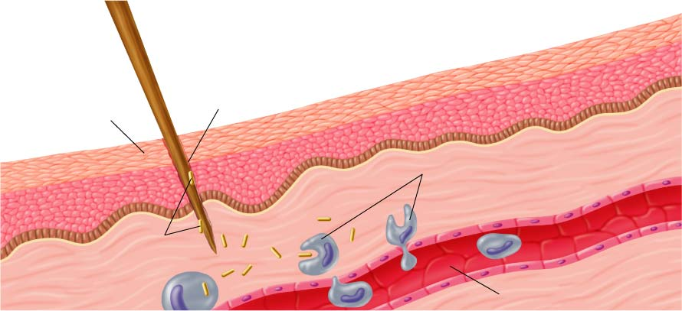
The Inflammatory Response
Wound
Skin
Phagocytes move into the area and engulf the bacteria and cell debris
Bacteria enter the wound
Capillary

Slide 28
Specific Defenses
An Immune Response: happens when a pathogen gets past the bodies nonspecific defenses. A substance that triggers the immune response is known as an antigen.
The two types of an immune response:
1. humoral immunity
2. cell-mediated immunity.

Slide 29
Humoral Immunity
In humoral immunity, a type of white blood cells, called B cells, produce antibodies that travel through the bloodstream attack pathogens in the blood.
They recognize “self vs non-self”. Antibodies know which antigens belongs in the body and which does not.

Slide 30
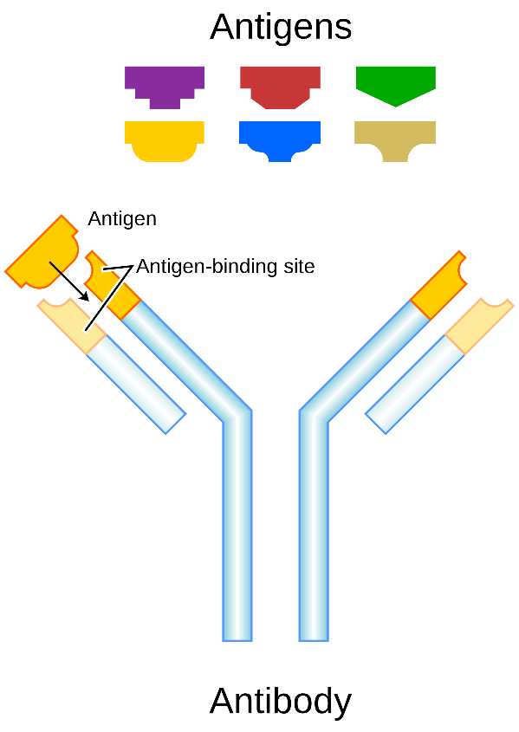
Structure of An Antibody
(NOTHING TO WRITE)
An antibody molecule has two identical antigen binding sites. It is at these sites that one or two specific antigens bind to the antibody.

Slide 31
Cell-mediated Immunity
In cell-mediated immunity, white blood cells, called T cells, track down and destroy abnormal or infected cells.
After a pathogen is destroyed, certain B cells and T cells, called memory cells, remain in the body. Memory cells can quickly respond to the same pathogen if it enters the body again.
This greatly reduces the chance that the disease develops again.
Cell mediated immunity is immunity against abnormal cells and pathogens inside living cells. For example when a virus gets inside a cell antibiotics will not work against it.

Slide 32
Immunity
Acquired Immunity appears after exposure to an antigen. For example: Vaccination is the injection of a weakened or mild form of a pathogen to produce immunity.
Passive Immunity is produced when antibodies enter the body. For example: Antibodies may be injected to fight an infection. Antibodies also pass from mother to child.

Slide 33
Immune System Disorders
There are three types of immune system
disorders:
1. Allergies are overreactions of the immune system to antigens such as pollen.
2. Autoimmune diseases occur when the immune system attacks the body’s own cells.
For example, in Type I diabetes
3. Immunodeficiency diseases occur when the normal immune response breaks down.

Slide 34
Preparing for the Big Event: Pregnancy

Slide 35
Reaction Time Lab!

