Slide 1
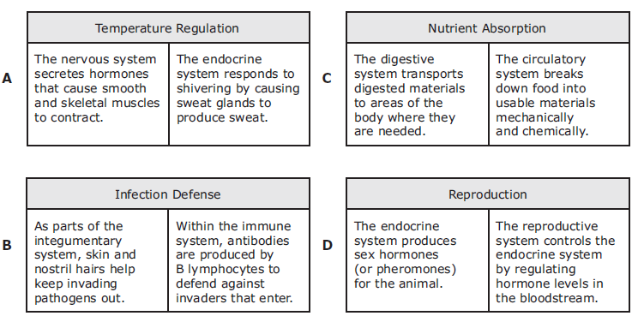
WARM UP Fri. (5/16)/Mon. (5/17)
Animal body systems often coordinate their actions to carry out specific functions for the whole animal. Which of these correctly describes the interaction of two biological systems for a specific purpose in the human body?
Exam: Binder Test 5/24 and 5/25
Answer: B

Slide 2
Objectives
Circulatory and Respiratory System Notes
Track Star Video
Reaction Time Lab

Slide 3
The Circulatory System

Slide 4
Circulatory System
Structures: Heart, blood vessels and blood.
Function: 3 types of blood vessels that carry oxygen and other nutrients through the heart.
The circulatory system and respiratory systems supply cells throughout the body with the nutrients and oxygen they need to do cellular respiration.

Slide 5
Blood Vessels
Arteries - carry oxygenated blood away from the heart under high pressure.
Capillaries – are the smallest of the blood vessels. They are involved in the exchanges of materials at the tissues by letting substances diffuse in and out of their walls. They supply food and oxygen and take away wastes like CO2.
Veins – carry the deoxygenated blood back to the heart at low pressure.

Slide 6
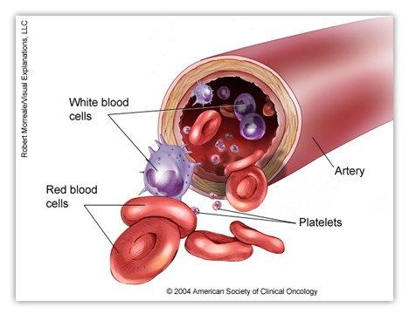
Red Blood Cells – have the job of carrying oxygen from the lungs to all the cells in the body. RBC’s contain hemoglobin which contains the mineral iron and gives the red color to blood.
White Blood Cells – used to fight against disease. WBC’s produces antibodies to fight microbes.

Slide 7
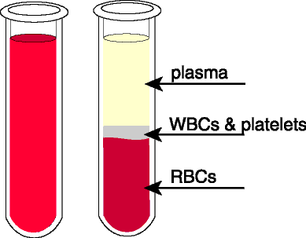
Plasma – is a pale yellow liquid part of the blood, which carries about everything that needs transporting around the body.

Slide 8
Humans Have a Double Circulatory System.
The first one: The heart pumps deoxygenated blood to the lungs to take in oxygen. Then it returns to the heart (now oxygenated).
The second one: The heart pumps oxygenated blood to the tissues of the entire body. Once the body cells use up the oxygen, it will pump back to the heart (now deoxygenated).

Slide 9
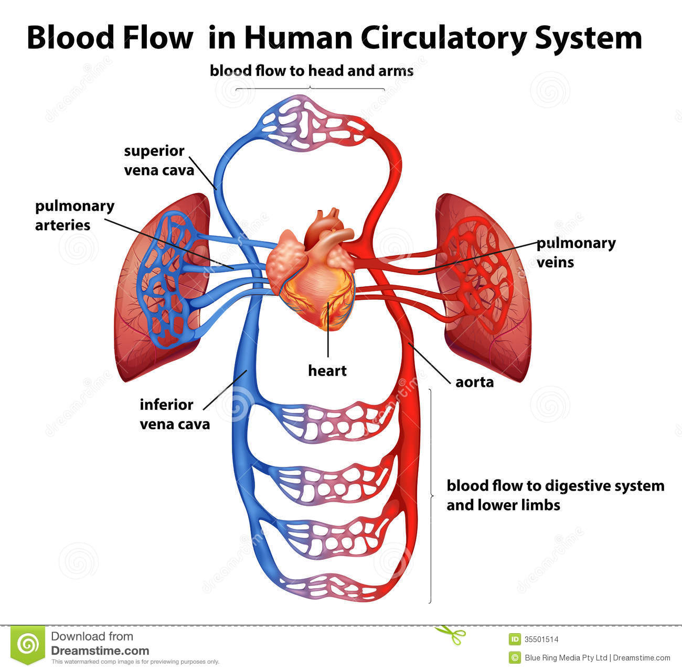

Slide 11
The Heart
Muscular organ that pumps blood throughout your body
Two Halves of the heart
Right Side- pumps blood to the lungs
Left Side- pumps oxygen-rich blood to the
body
Chambers
2 Upper Chambers- Right and Left atrium
2 Lower Chambers- Right and Left ventricle

Slide 12
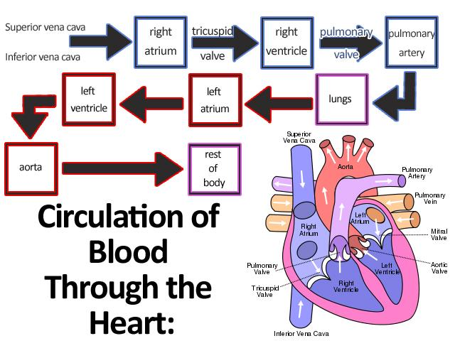
Blood Flow Clip

Slide 13
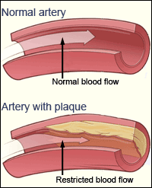
Cardiovascular Diseases
Atheriosclerosis- narrowed arteries due to fatty deposits; hardened by calcium
Reduced blood flow
Increase clotting
Blocked flow to heart muscle-> heart attack
Blocked flow to the brain -> stroke
https://www.youtube.com/watch?v=zfAqC1oPbkw

Slide 14
Cardiovascular Diseases Cont’d
Hypertension- AKA high blood pressure- the force of blood flow which applies pressure to the arterial walls
Caused by heredity, diet or smoking
Number of deaths for leading causes of death
1. Heart disease: 611,105
2. Cancer: 584,881
3. Chronic lower respiratory diseases: 149,205
4. Accidents (unintentional injuries): 130,557
5. Stroke (cerebrovascular diseases): 128,978
6. Alzheimer's disease: 84,767
7. Diabetes: 75,578
8. Influenza and Pneumonia: 56,979
9. Nephritis, nephrotic syndrome, and nephrosis: 47,112
10. Intentional self-harm (suicide): 41,149
From CDC 2013
#1 Cause of Death… 63 Million Americans have Cardiovascular Disease

Slide 15
The Respiratory System

Slide 16
Respiratory System
Structures: Lungs, pharynx, larynx, trachea, bronchi.
Function: gas exchange: exchange of oxygen and carbon dioxide between the blood, the air, and tissues of the body.

Slide 17
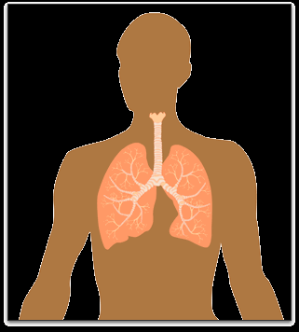
What is Respiration?
Respiration- the process of breaking down glucose (using OXYGEN ) to release energy, which goes on in every cell
Respiration- happens in all living things. It’s how they get energy from their food.

Slide 18
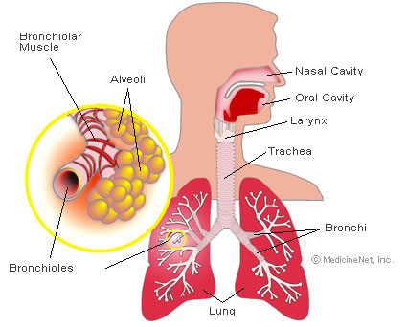
Follow Air Through Your Respiratory System
MOUTH
to
PHARYNX
to
Larynx (voicepipe)
to
TRACHEA – main passageway
to
the LUNGS

Slide 19
Airflow cont.
Once in the lungs, air flows through the bronchi which branch off into bronchioles. At the ends of the bronchioles, there are tiny air sacs called alveoli.

Slide 20
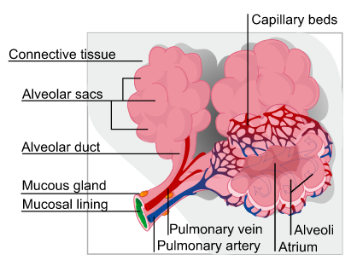
Lungs and Internal Structures
Cells need oxygen and nutrients. They need to excrete waste products like CO₂. Humans exchange oxygen and carbon dioxide through their lungs.
Alveoli- have thin permeable walls that are surrounded by capillaries for gas exchange (diffusion) with blood

Slide 21
Gas Exchange
Oxygen is carried by a PROTEIN in the blood called hemoglobin
The medulla oblongata of the brain monitors the amount of carbon dioxide in the blood. High concentrations of CO2 lead to deeper or faster breathing, which results in an intake of more oxygen. Simultaneously, CO2 is exhaled as waste.

Slide 22
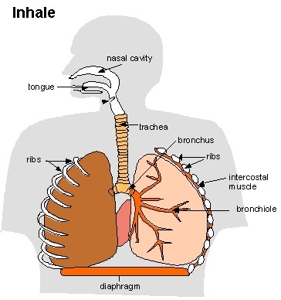
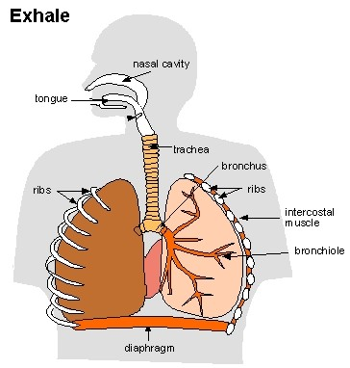
Other Parts of the Respiratory System
Diaphragm- when the air pressure on the outside differs from the pressure on the inside of the body, the brain sends a signal to the diaphragm. It contracts making the chest cavity enlarge – taking in air called inhalation; When the diaphragm relaxes, it reduces the size of the chest cavity forcing air out called exhalation

Slide 23
Filtration System to Purify Air You Breathe
Nose hairs and Mucus- trap small particles of dust and bacteria
Cilia- moves mucus and it’s trapped particles to the throat to be swallowed
Coughing and sneezing –clears excess mucus

Slide 24
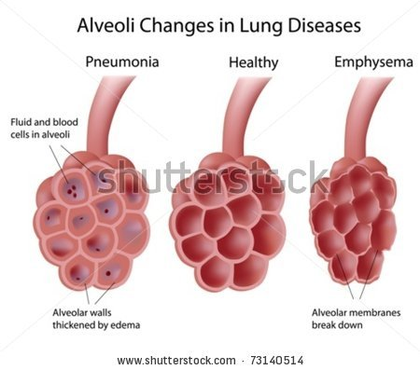
Emphysema- a form of COPD
Factors like smoking and inhaling dangerous chemicals weaken the walls of the alveoli. This makes it harder for gases to exchange and in turn harder to breath and perform routine daily activities.
15 Million Americans have COPD and approximately 12 Million have it but do not know it.
80%-90% are caused from smoking
https://www.youtube.com/watch?v=T1G9Rl65M-Q

Slide 25
Preparing for the Big Event: Pregnancy

Slide 26
Reaction Time Lab!

