Slide 1
WARM UP Wed. (5/10)/Thurs. (5/11)
Coracias garrulus is a blue bird with an orange-brown back. The offspring of this bird have an effective defense mechanism. The young birds vomit and cover themselves in a foul-smelling orange liquid when they sense a threat by predators. Which two systems alert the young bird to the danger and help produce the vomit it uses as a defense?
A. Nervous and digestive systems
B. Integumentary and muscular systems
C. Immune and respiratory systems
D. Excretory and reproductive systems
Answer: A
Exam:Binder Test 5/24 and 5/25

Slide 2
Objectives:
Digestive/Excretory Notes
Speed Skater
Heart Rate Lab
Digestive System Demo (Mr. Holm and Vincent)

Slide 3
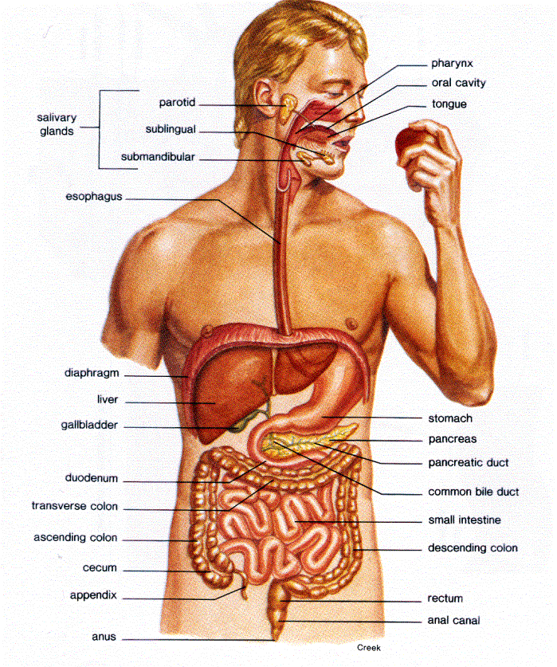
The Digestive System Pg. 3-4
Digestive System BrainPop: http://www.brainpop.com/health/bodysystems/digestivesystem/

Slide 4
Function of the Digestive System (nothing to write)
To break down food into simpler molecules that can be absorbed and used by cells.
Digestion Animation (1:49)
http://www.youtube.com/watch?v=b20VRR9C37Q

Slide 6
Structure/Organs of the Digestive System (nothing to write)
Main structures include:
Mouth
Pharynx
Esophagus
Stomach
Small intestines
Large intestines

Slide 7
Digestion
There are Two Types of Digestion:
Mechanical: physical breakdown of food (mouth)
Chemical: chemical breakdown of food (mouth, stomach, intestines)
Digestive System Song (3:19): http://www.youtube.com/watch?v=SyVcyT-fOao

Slide 8
Digestion and Enzymes (nothing to write)

Slide 9
Digestion Organs and Enzymes
Salivary glands:- produce amylase enzymes in the saliva.
Stomach:-
1) pummels the food with the muscular wall.
2) produces pepsin.
3) produces hydrochloric acid to kill bacteria and maintain pH 2.

Slide 10
SMALL INTESTINE
Small intestine:-
1) produces protease, amylase and lipase to complete digestion.
2) nutrients are absorbed into the body / blood stream.

Slide 11
More Digestive Organs
Large Intestine:- Where excess water is absorbed from the food.
Rectum:- Where the feces (mainly undigested food) are stored before they are removed out through the rectum.

Slide 12
Villi in the small intestine
The small intestine is adapted for food absorption (into the bloodstream)
Villi in the small intestine increase surface area for absorption.
Villi have a single permeable layer of surface cells and a good blood supply to assist quick absorption.
How Celiac Disease Affects Villi (0:42): http://www.youtube.com/watch?v=IC8MiBt5-Dg

Slide 13
Accessory Digestive Organs
Liver:- Bile is produced which neutralizes stomach acid and emulsifies (breaks the fat into tiny droplets) fats.
Gall bladder:- Bile is stored before being released into the small intestine.
Pancreas:- produces enzymes protease, amylase and lipase. These are released into the small intestine.

Slide 14
Path of Food
Digestion Video
Mouth
↓
Esophagus (peristalsis)
↓
Stomach
↓
Small Intestines (villus)
↓
Large Intestines

Slide 15
MOUTH/SALIVARY GLANDS
ESOPHAGUS
LIVER
STOMACH
GALL BLADDER
PANCREAS
LARGE INTESTINES
SMALL INTESTINES
APPENDIX
RECTUM
ANUS

Slide 16
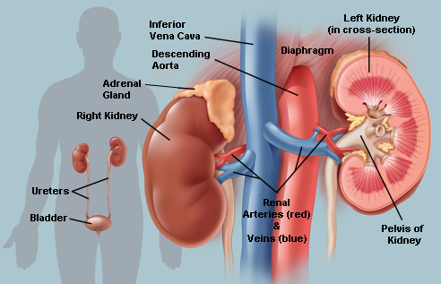
The Excretory System
Urinary System BrainPop: http://www.brainpop.com/health/bodysystems/urinarysystem/

Slide 17
What is the function of the Excretory System? (nothing to write)
1. Excretion controls water levels and removes waste
2. Maintains balanced osmosis
3. Maintains pH balance

Slide 18
Structures of Excretory System (nothing to write)
Kidney
Nephron
Ureter
Urinary bladder
Urethra
Urinary System Song:
http://www.youtube.com/watch?v=K3Z-Lt58H0s

Slide 19
What is Urea?
Proteins cannot be stored by the body. Extra proteins are therefore usually converted into fats and carbohydrates.
This conversion usually occurs in the liver. UREA is produced as a waste product from this process.
UREA is poisonous. The liver releases it into the bloodstream. The kidneys remove the urea and release it from the body in urine.

Slide 20
The Kidney
Two bean-shaped, fist sized organs in the lower back
Remove urea, excess water and other substances from blood.
Salt is necessary to maintain osmotic balance (ideal amount of water in the body)
Kidney Video (2:01) http://www.youtube.com/watch?v=qdP3zBaDCv0

Slide 21
A Nephron (nothing to write)
Approx. 1 million blood filtering tubes in a kidney.
3 steps as blood filters through a nephron:
Filtration
Reabsorption
Secretion

Slide 22
Nephron Step 1: Filtration nothing to write
Water, salt, glucose, amino acids, and urea (nitrogen waste) filtered into Bowman’s capsule
This fluid is called filtrate
Blood cells, proteins, other large molecules remain in blood.

Slide 23
Nephron Step 2: Reabsorption
Filtrate goes through renal tubules
Glucose, ions, and some water are removed from filtrate
These are absorbed back into the bloodstream

Slide 24
Nephron Step 3: Secretion (nothing to write)
Some substances pass from the blood into the filtrate

Slide 25
Ureter
Urine is formed from water, urea, and salt left after absorption and secretion
Ureters carry the urine from the kidney to the urinary bladder.

Slide 26
Urinary Bladder
Hollow muscular sack
Holds urine
On average, 0.63 quarts

Slide 27
Urethra
Urine leaves the bladder and the body through this tube.

Slide 28
ADH
Antidiuretic hormone
This stimulates reabsorption of water from the kidney.
It constricts blood vessels.

Slide 29
DIALYSIS: Artificial Kidneys (Nothing to write)

Slide 30
KIDNEY
VEIN
ARTERY
URETER
BLADDER
INTERNAL SPHINCTER
URETHRA

Slide 31
Heart Rate Lab – Pg. 14-15
Seconds:
0-30 Exercise
30-35 Locate Pulse
35-50 Take Pulse
50-60 Record
Seconds:
0-15 Take Pulse
15-25 Record
25-30 Find Pulse
30-45 Take Pulse
45-55 Record
55-60 Pulse

